Slide 1
Budget Project for 2021
Abigaik De La Cruz
Period : 4
March 12, 2021

Slide 2

Reasons for Choosing the Nursing Profession (Registered Nurse)
I wanted to do a job that assists individuals and positively affects the lives of patients.
There is a steady industry growth, and nurses are in demand due to increased access to health insurance and advances in health care.
It is busy work that involves working with a dedicated team of healthcare providers daily.
There are various professional development opportunities that can help one learn new things every day.
Nursing has a flexible work schedule that can help one plan on how they can spend time with their family

Slide 3

Qualifications
Clinical training enables one to acquire hands-on knowledge and connects with nurses as they ask questions in real-life situations.
One must complete clinical requirements in a medical setting in the community and working in well-lit healthcare facilities.
One must have a bachelor's degree in nursing.
Associate degree in nursing.
One must get licensed to practice.

Slide 4
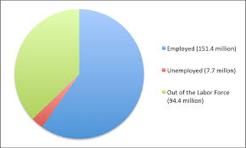
Unemployment Percentage
Considering the current job environment, individuals perceive Registered nurses to be quite lucky since their unemployment percentage is 1.1 percent.
America's population is growing old, meaning a high demand and more treatment alternatives for most kinds of illnesses.
The need for nurses has continued to increase significantly during the pandemic and emergencies.

Slide 5

Job Environment
The job will be located in New York.
Job pressures include medical emergencies and dealing with grief after a patient’s death.
Responsibilities involve coordinating patient care, helping doctors with surgeries and exams, promoting wellness, educating patients, and administering medication.
Co-workers include doctors and fellow nurses.
Indoor activities involve working in a healthcare facility environment, while outdoor may include caring for the elderly at their homes.

Slide 6

Tax and Retirement
Gross income per year is $ 85,610 in New York.
Federal income tax- pay 25 % - $21,402
FICA- pay 6% - $5,136
State income tax- pay 6%- $5,136
Net income per year - $53,936
Net income per month - $ 4,495
Concerning retirement, financial planners recommended I pay myself first and save 10 percent to invest in future.
Thus, total retirement will be $ 449.50

Slide 7
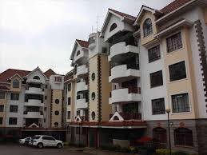
Housing and Utilities
The location of the housing is NYC (Manhattan).
The type of housing is an apartment.
My room mate name is James Clarkson.
Total rent per month is $725.
Electricity per month is $220
Water per month is $10
Cable/Setellite/Membership per month is $8
Cellphoner per month is $68
Internet services per month is $38
Total utilities per month is $344.

Slide 8
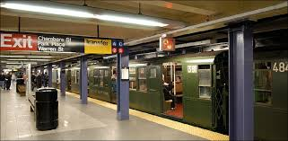
Automobile and Gas
Since I will be residing in NYC, I do not need to get a car. For transportation, I will prefer using the subway and walking.
The cost for 30 days pass is $121.00.
Because there is no need of purchasing a car, I will not incur costs regarding gas for the automobile.

Slide 9

Insurance
Rental insurance per month will be $14 from Liberty Mutual company.
Total life insurance per month will be $17.93 from Legal General company.
Health insurance plan cost monthly will be $420.
The total monthly insurance cost will be $451.93.
The plan for health insurance is Fidelis care and the insurance will pay 100%.
I will be accountable for paying 0 % and the deductible amount will be $4,000.
Copayments and coinsurance amount 50% after deductible while out-of-pocket maximum will be $7,600.

Slide 10
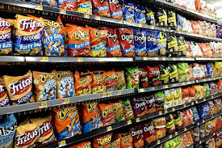
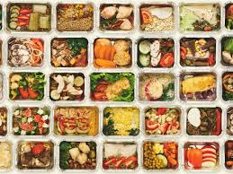
Food and Groceries
Mondays_ breakfast will be vanilla yogurt, mangoes, and tea Lunch, including green beans, chicken, and spinach, while dinner will consist of meat, lettuce, and rice. Snacks will be celery.
Tuesdays_ breakfast will be coffee, vanilla yogurt, and mangoes. Lunch will include almonds, salad with spinach, and chicken. Dinner will be chicken breast with grilled broccoli and green beans. Snacks will be biscuits.
Wednesdays-_breakfast will include eggs, Greek yogurt, and coffee. Lunch will consist of a chicken sandwich with broccoli salad. Dinner will consist of meatballs with lemon zucchini noodles. Snacks will be mixed nuts.
Thursdays- breakfast will be oatmeal, berries, and tea. Lunch will include an avocado and eggs sandwich and lentil soup. Dinner will consist of salmon with spinach and dried tomatoes. Snacks will be apple slices with peanut butter.
Fridays-breakfast will be nuts, green tea, and a protein shake. Lunch will include lentil vegetable soup and rice. Dinner will consist of garlic chicken with potatoes. Snacks will be dark chocolate and almond.
Saturdays- breakfast will include protein shakes, cheese, and bananas. Lunch will be a chicken burrito, beans, and rice. Dinner will consist of sausage and cauliflower fried rice. Snacks will be cucumber slices with hummus.
Sundays-breakfast will include cottage cheeses, flaxseeds, and coffee. Lunch will consist of protein salad. Dinner will be lime shrimp with zucchini noodles. Snacks will be ruffles. The weekly cost will be $125.5, and the monthly fee will be $502.00.

Slide 11
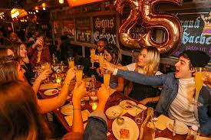
Entertainment
Week 1- I will be going to the movies in AMC Empire 25 movie theatre in NYC. The cost will be $23.29.
Week 2- I will visit the Syndicate sidewalk cinema. I am hoping to spend $50 on food and drinks.
Week 3- I will enjoy brunch at Essex, Manhattan. It will be inclusive of mimosas with an entree, screwdrivers, and unlimited blood Mary's. The costs will be $19.95 for entrée and $34.0 for drinks totaling $53.95.
Week 4- I will be doing an escape room with my colleagues, escaping an alien encounter. The costs will be $29.00.
The total for all weekends will be $156.85.

Slide 12

Clothing
I will purchase a lady’s premium blouses statue of liberty for $23.99 from spreadshirt.com.
I will purchase a Lee Lady’s regular fit straight leg jeans at $34.99 from davesnewyork.com.
The total monthly clothing costs is $58.98

Slide 13
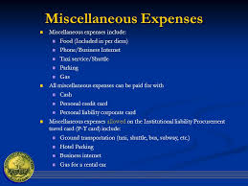

Miscellaneous Expenses
Personal hygiene
Tooth paste: crest $2.99, bath and body works shower gel at $6.00, deodorant at $14.94 and hand soap at $10.05.
Cleaning supplies
Toilet cleaner at $11.97, dish soap at $2.69.
Laundry costs
Detergent at $11.97 and fabric softener at $6.80.
Other
Amazon prime membership fee at $9.92 monthly.
Total cost of miscellaneous is $77.6

Slide 14

Screw-Up Payment
I had over drafted my bank account and was forced to pay $34.00
Total monthly screw-up payment is $35.00.

Slide 15

Investment
The amount I will invest each month is $449.50. I will use Roth IRA.
I plan to invest for 40 years.
Plans involve investing some of my money back and giving the other to my children.

Slide 16
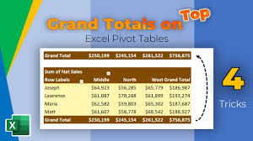
Grand Total
Retirement is $449.50
Housing $725
utilities $344
Subway $121
Insurance $451.93
Food $502.0
Entertainment $156.85
Clothing $58.98
Miscellaneous $77.6
Screw-up payment $35
Investment $449.50
Total expenses $3,371.36
Saved $1,119.70

